Slide 1


Teacher name: Ruchita Samuel Student name: Ayushman Samal

Slide 2

Angle and its types

Slide 3
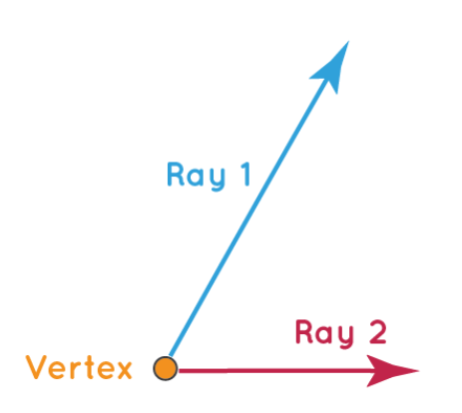
What is an angle?
Two rays that share the same end point form an angle. The point where two rays meet is called vertex.

Slide 4
Types of angles
Zero angle
Acute angle
Right Angle
Obtuse angle
Straight Angle
Reflex angle
Complete angle

Slide 5
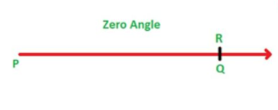
Zero angle
A zero angle is an angle formed when both the arms of an angles are at the same position.

Slide 6
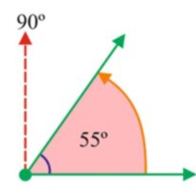
Acute angle
The angle whose measure is greater than 0 degree but less than 90 degree, is called an acute angle.

Slide 7
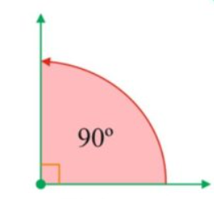
Right angle
A right angle is a type of angle whose measure is exactly equal to 90∘.

Slide 8
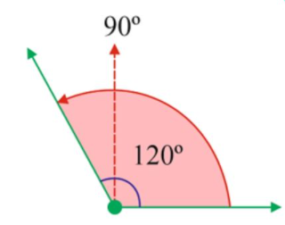
Obtuse angle
An obtuse angle is a type of angle whose measure is greater than 90∘ and less than 180∘.Examples: 100∘,120∘,150∘ etc.

Slide 9
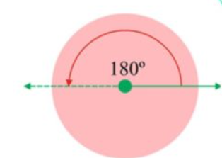
Straight angle
A straight angle is a type of angle whose measure is exactly equal to 180∘. It is also called 180∘ angle.

Slide 10
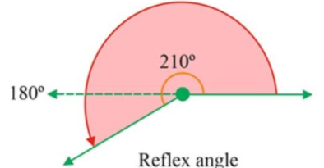
Reflex angle
A reflex angle is a type of angle whose measure is greater than 180∘ and less than 360∘.Example: 200∘,220∘,250∘ etc.

Slide 11
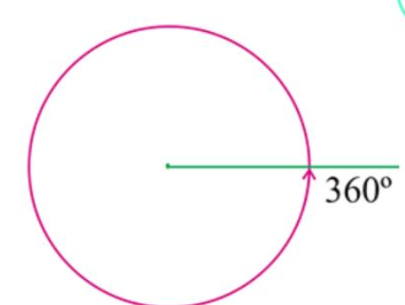
Complete angle
A complete angle is a type of angle whose measure is exactly equal to 360∘. It is also called a full angle.

Slide 12
Types of Angles Based on Rotation
Based on the direction of measurement or the direction of rotation, angles are of 2 types:
Positive Angles
Negative Angles

Slide 13
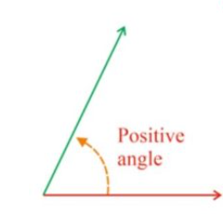
Positive Angles
The angles that are measured by the counter clockwise (or anti-clockwise) direction are called positive angles.

Slide 14
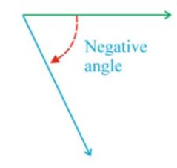
Negative Angles
The angles that are measured in a clockwise direction from the base are called negative angles.

Slide 15
Pairs of Angles
When 2 angles are paired, then they form different angles, like
Complementary angles
Supplementary angles
Linear Pair
Adjacent angles
Vertically Opposite angles

Slide 16
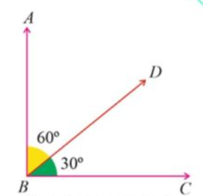
Complementary Angle
Two angles whose sum is of 90∘ are known as complementary angles. Whenever two angles are said to be complementary.

Slide 17
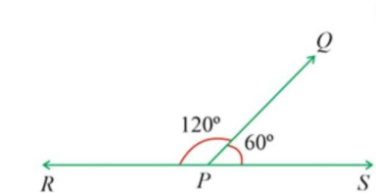
Supplementary angle
Two angles whose sum is of 180∘ are known as supplementary angles.

Slide 18
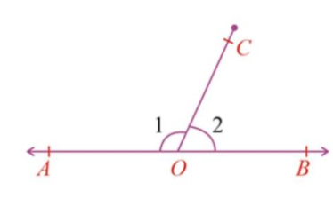
Linear pair
A linear pair of angles is formed when 2 lines intersect. Two angles are said to be linear if they are adjacent angles formed by 2 intersecting lines. The measure of a straight angle is 180∘.

Slide 19
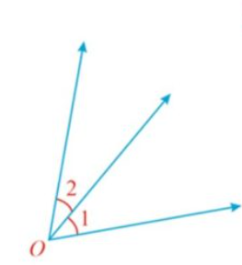
Adjacent angle
Adjacent angles are two angles that have a common vertex and a common side but do not overlap. They share the same vertex and the same common side.

Slide 20
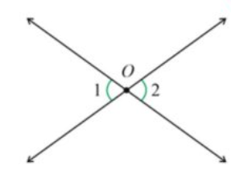
Vertical opposite angles
When two lines intersect, the opposite angles are equal.

Slide 21
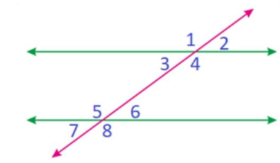
Angles Formed by Transversal
A line that intersects two or more lines at different points is known as a transversal.
The angles formed at the point of intersection are,

Slide 22
Interior Angles
The inner of the two angles formed where two sides of a polygon come together. ∠3,∠4,∠5 and ∠6 are interior angles.

Slide 23
Exterior Angles
The exterior Angle is the angle between any side of a shape, and a line extended from the next side. ∠1,∠2,∠7 and ∠8 are exterior angles.

Slide 24
Pairs of Alternate Interior Angles
Pairs of alternate interior angles are pair angles formed when a line intersects two parallel lines. Alternate interior angles are always equal. ∠3&∠6 and ∠4&∠5 are two pairs of alternate interior angles. ∠3=∠6 and ∠4=∠5

Slide 25
Pairs of Alternate Exterior Angles
Pairs of alternate exterior angles are pair angles formed when a line intersects two parallel lines. Alternate exterior angles are always equal. ∠1&∠8 and ∠2&∠7 are two pairs of alternate interior angles. ∠1=∠8 and ∠2=∠7

Slide 26
Pairs of Corresponding Angles
Corresponding angles are pair angles formed when a line intersects a pair of parallel lines. Corresponding angles are also equal. ∠1=∠5,∠3=∠7,∠2=∠6 and ∠4=∠8 are four pairs of corresponding angles

Slide 27
Pairs of Interior Angles on the Same Side of the Transversal
∠3&∠5 and ∠4&∠6 are two pairs of interior angles on the same side of the transversal. These pairs of angles are supplementary. So, ∠3+∠5=180∘ and ∠4+∠6=180∘.

